Slide 1

Microsoft Movie Studio

Slide 2
Overview
Analyzing the global film market landscape
Help decision making about
What GENRE of Movie to make
How MUCH to invest
When to RELEASE

Slide 3


Outline
Business Problems
Data & Method
Analysis of Data
Recommendations

Slide 4
Business Problems
Entering a new business field
Developing new revenue streams
Ensuring the success of first-time project

Slide 5


Data
“The Numbers” dataset has 5,782 film data that includes the information on release time, production budget, domestic sales, and foreign sales of each movie.
The “IMDB” provides the 146,144 film dataset that contains records showing the title and genres of each movie.

Slide 6
Method
The return on investment ( R O I ) =
( domestic sales + foreign sales ) / budget
The Genre : movies grouped into single and mixed genres
calculate the average R O I of the movies by genres
The budget : divided into 22 different sizes, increasing by 20 Million,
and the average R O I of each budget was compared by size
The timing : movies grouped by month, and comparing
the average ROI and the number of movies of each month

Slide 7
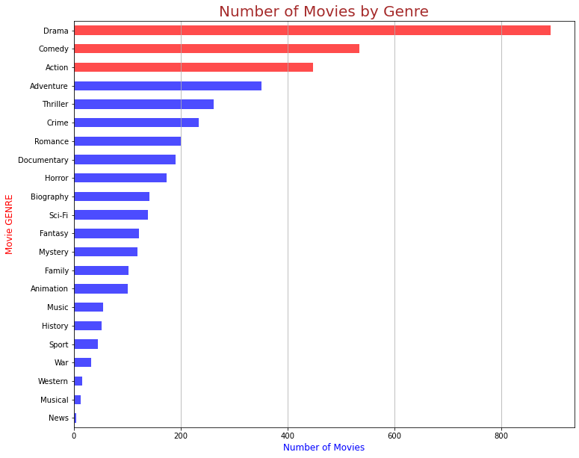
Analysis 1. GENRE
Among the 4,226 sample, 'Drama' is the most common movie genre.

Slide 8
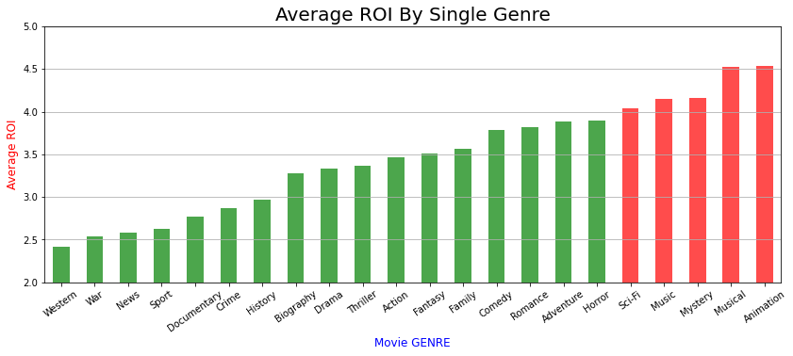
The most profitable movie genre is 'Animation' then 'Musical', 'Mystery', 'Music' and 'Sci-Fi'

Slide 9
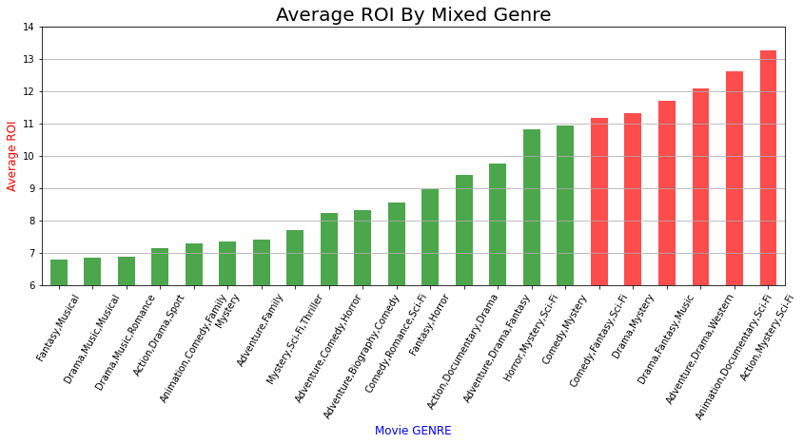
Action-Mystery-Sci-Fi, Animation-Documentary-Sci-Fi, Adventure-Drama-Western,
Drama-Fantasy-Music, and Drama-Mystery genres were the most profitable mixtures

Slide 10
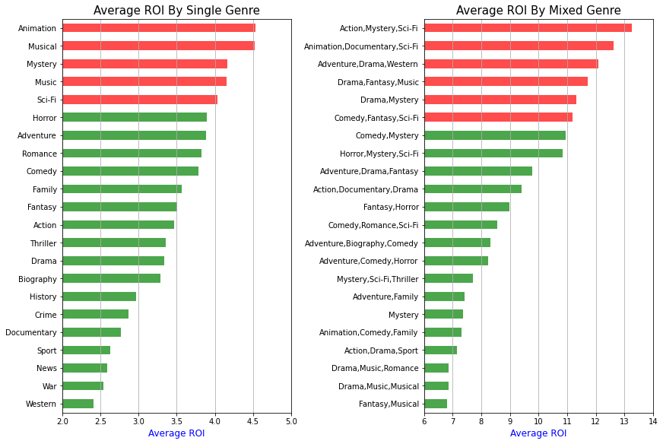
Most profitable
Single genres :
Animation, Musical
Mystery, Music, Sci-Fi
Mixed genres :
- Action-Mystery-Sci-Fi
- Animation-Documentary- Sci-Fi
- Adventure-Drama-Western
Drama-Fantasy-Music
Drama-Mystery
Comedy-Fantasy-Sci-Fi

Slide 11
Analysis 1. GENRE - RESULT
The most common movie genres : Drama, Comedy and Action
The high 'ROI' movie genre :
Single genre : Animation, Musical, Mystery, Music, Sci-Fi
Mixed genres : Action-Mystery-Sci-Fi, Animation-Documentary-Sci-Fi,
Adventure-Drama-Western, Drama-Fantasy-Music, and
Drama-Mystery, Comedy-Fantasy-Sci-Fi
Appear in common and most frequently in both genres : Mystery, Sci-Fi,
Animation, Drama, Fantasy

Slide 12
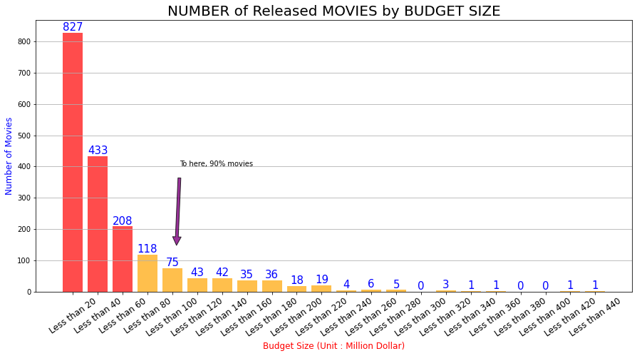
Analysis 2. BUDGET
Of the 1876 movies, 45% of movies - with a budget of less than 20 million
90% of movies - with a budget of less than 100 million

Slide 13
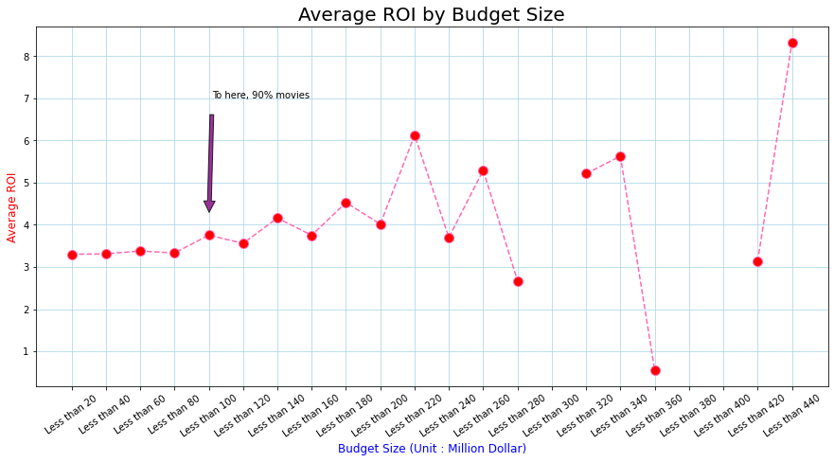
Of the 1876 movies, ROI of 90% movies - not much different
The movies with a budget of over 100 million : too few to be considered

Slide 14
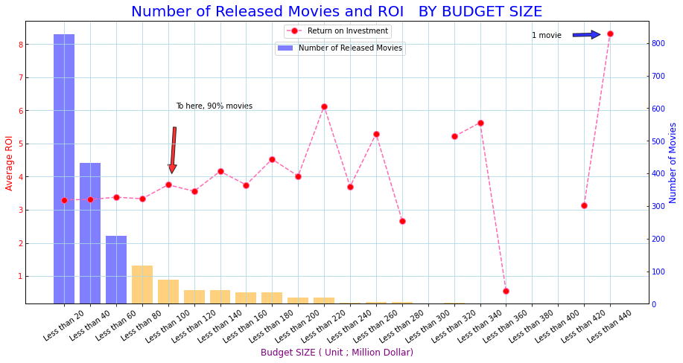

Slide 15
Analysis 2. BUDGET - RESULT
Budget Under 20 Million Dollars – 45% of Movies
Budget Under 100 Million Dollars – 90% of Movies
The ROI by Budget – not much different
Budget over 100 Million Dollars – too few to be considered

Slide 16
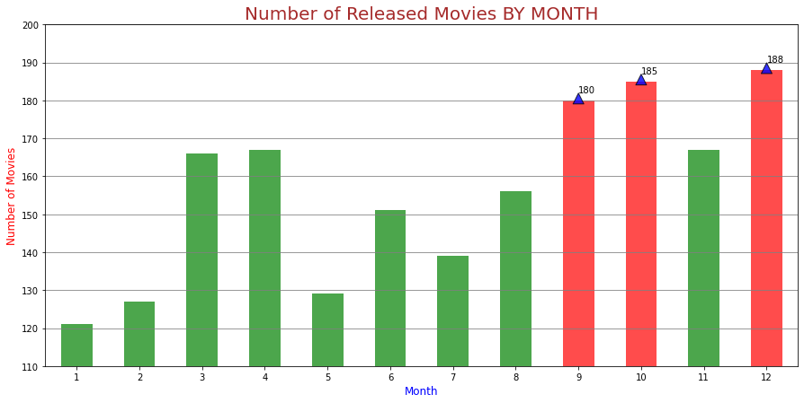
Analysis 3. RELEASE TIMING
The largest number of released movie – DECEMBER, OCTOBER, SEPTEMBER

Slide 17
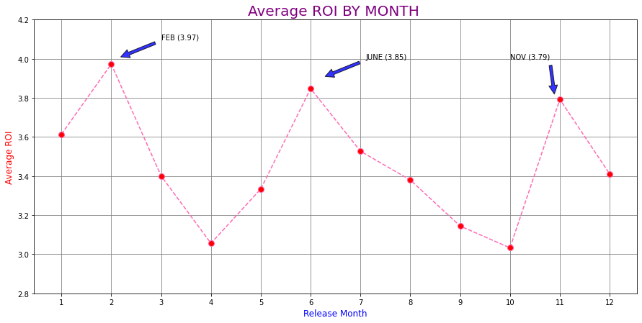
The Highest ROI – FEBRUARY, JUNE, NOVEMBER

Slide 18
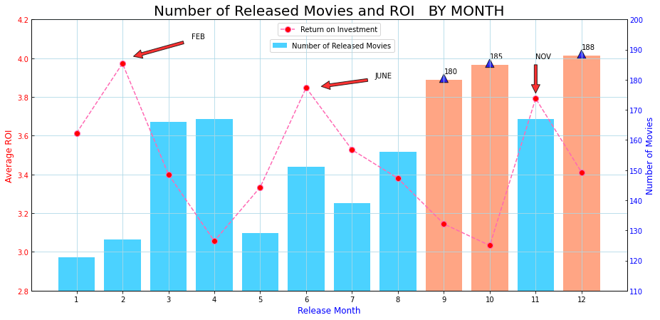
The months in which many movies are released are generally not profitable.

Slide 19



Analysis 3. RELEASE TIMING - RESULT
A large number of films are released in
December, October, September.
But the profitability was not very good.
Rather, movies released in FEBRUARY, JUNE, NOVEMBER
show the best profitability.

Slide 20

Recommendations
What Genre of Movie to Make
Mixing two or three of these Genres :
Mystery, Sci-Fi, Animation, Drama, Fantasy
How Much to Invest
Less Than 100 Million
When to Release
FEBRUARY, JUNE, NOVEMBER

Slide 21

Thank You !
Email : jwchung60@gmail.com

